Slide 1
Vestibular Assessment using Video Head Impulse Testing (vHIT)
October 2017
Kathleen Hill, AuD – Education & Training Manager
Otometrics/Audiology Systems, a division of Natus

Slide 2
Today’s Agenda
Current Status of Vestibular Assessment
History of the Head Impulse Test (HIT)
Performing the vHIT with ICS Impulse
Interpretation/Patient Data
vHIT in the Modern Clinic
vHIT Findings

Slide 3
Current Status of Vestibular Assessment
Typical VNG protocol consists of:
Oculomotor testing – Central Lesion
Positional Testing
  Static Positional Testing – Typically non-localizing
  Dynamic Positional Testing (Dix-Hallpike) – Peripheral Lesion
Calorics – Peripheral finding (usually)
Both calorics and dynamic testing usually indicate peripheral findings and lateralization of lesion
But…
Time consuming
Good case history and bedside tests could eliminate certain parts of VNG battery
Calorics have been the definitive test for decades, but it’s not perfect
  Unpleasant, indirect measurement, time consuming, potential for carry-over
Limited scope – not able to assess all canals; variance of ‘asymmetry’ levels

Slide 4
Current Status of Vestibular Assessment
Rotary Chair Testing
Typically used to verify bilateral weakness from caloric testing
Can be performed on patients with middle ear disorder
Can assess utricular function with off-axis testing (not common)
But…
VERY Expensive
Incredibly large footprint
Not pleasant for patient
Insensitive to many common peripheral vestibular lesions

Slide 5
Foundation of Head Impulse Testing

Slide 6

Head Impulse: The Beginning
Halmagyi GM, Curthoys IS. A clinical sign of canal paresis. Arch Neurol 1988; 45(7):737-739.

Slide 7
Overview of Head Impulse testing
Described in 1988 by Drs. Halmagyi and Curthoys as a bedside test of the vestibulo-ocular reflex (VOR).
Examiner monitors eye movement as the head is thrust to the left or right. The patient is fixating on an object, typically the examiners nose.
Horizontal head thrusts test the lateral semicircular canals - testing vertical canals is more difficult

Slide 8
The Vestibulo-ocular Reflex
A reflexive eye movement that stabilizes images on the retina by producing eye movement in the opposite direction of head movement.
Mediated by the semicircular canals.
Eye movement must equal head movement in the opposite direction to maintain gaze. Normal VOR has a gain near 1.0.
Notes:
Gain= change in eye velocity/change in head angle

Slide 9
What does the VOR show with bedside/visual observation?
Patients produced the following movements:
1. Normal: Patient’s eyes remain fixated on the target
2.Catch-up saccade: Patient makes a corrective eye movement to the target post-head movement. Visible to an observer.
Notes:
Find sensitivity specificity of visual observation?

Slide 10
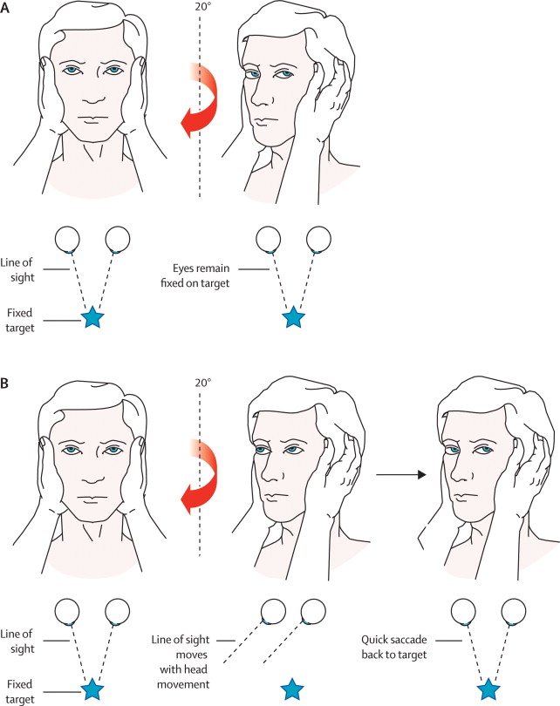
Bedside Procedure - Normal
Edlow, JA, Newman-Toker, DE, Savitz, SI.Diagnosis and initial management of cerebellar infarction. Nuerology 2008; 7(10):951-962
Notes:
Halmagyi GM, Curthoys IS. A clinical sign of canal paresis. Arch Neurol 1988; 45(7):737-739
The Lancet Neurology, Volume 7, Issue 10, Pages 951 - 964, October 2008
Diagnosis and initial management of cerebellar infarction
Jonathan A Edlow, MD^{a, ,} ,
David E Newman-Toker, MD^{b},
Sean I Savitz, MD^{c}
ª Department of Emergency Medicine, Beth Israel Deaconess Medical Center, and Harvard Medical School, Boston, MA, USA
^{b} Departments of Neurology and Otolaryngology, The Johns Hopkins University School of Medicine, and Department of Epidemiology, The Johns Hopkins Bloomberg School of Public Health, Baltimore, MD, USA
^{c} Stroke Program, University of Texas, Houston, TX, USDA

Slide 11
Bedside Procedure - Abnormal
Edlow, JA, Newman-Toker, DE, Savitz, SI.Diagnosis and initial management of cerebellar infarction. Nuerology 2008; 7(10):951-962

Slide 12
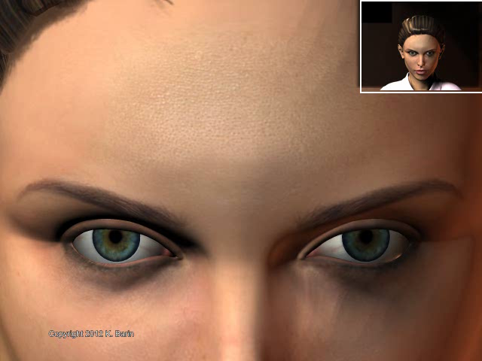
Animation courtesy of Kamran Barin, PhD

Slide 13
Visual Observation – How effective is it?
Surgically induced deficit (nerve section)
  Sensitivity & Specificity: 100%
Non-surgically induced unilateral hypofunction
(clinical population)
Specificity: 95 to 100%
Sensitivity: 34 to 39%
Schubert MC, Tusa RJ, Grine LE, Herdman SJ. Optimizing the sensitivity of the head thrust test for identifying vestibular hypofunction. Physical Therapy 2004; 84(2):151-158.
Notes:
For patients with nonsurgically induced unilateral hypofunction, a group that more accurately reflects a clinical population, the HTT has a sensitivity of 34% to 39% and a specificity of 95% to 100%.^{9–11}

Slide 14
Visual Observation Limitations
Early experience with bedside head impulse produced mixed results
  Calorics and head impulse tests did not always match
Why? Partially because it is subjective – and the examiner does not have feedback on how well the head impulse was delivered
  100 deg/sec to reach VOR (want 100-250 deg/sec)
    < 50 deg/sec – occulomotor response
    50-100 deg/sec – both occulomotor and VOR
    > 100 deg/sec – all VOR
    > 300 deg/sec – too uncomfortable

Slide 15
Another limitation…
It turns out that patients actually produced one of three of eye movements:
1. Normal: Patient’s eyes remain fixated on the target
2. Overt saccades: Patient makes a corrective eye movement to the target post-head movement. Visible to an observer.
3. Covert saccades: Patient makes corrective eye movement to the target DURING the head movement. May not be visible to an observer.
Notes:
Find sensitivity specificity of visual observation?

Slide 16
Covert!
Animation courtesy of Kamran Barin, PhD

Slide 17
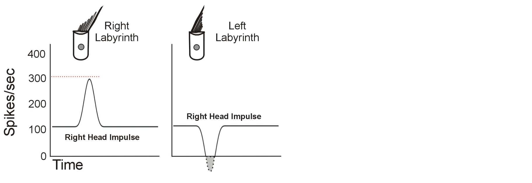
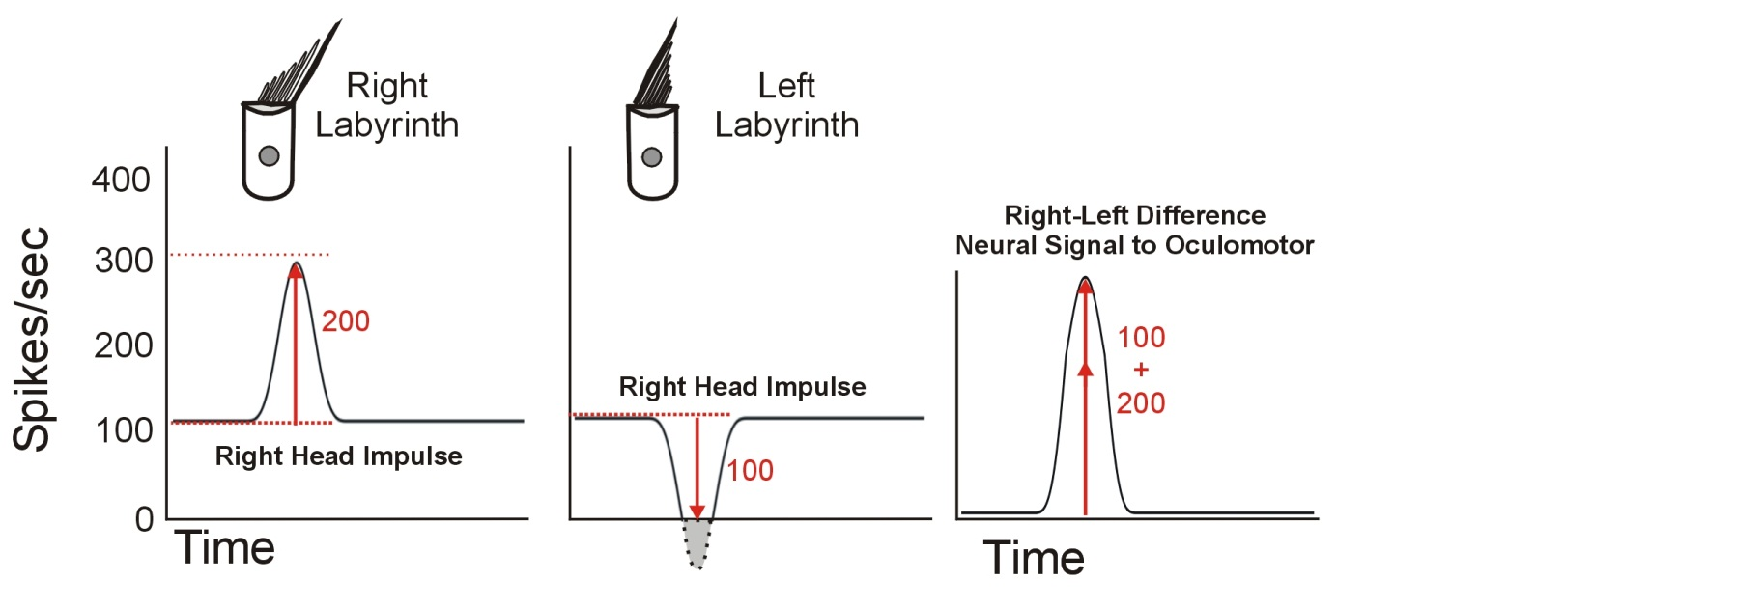
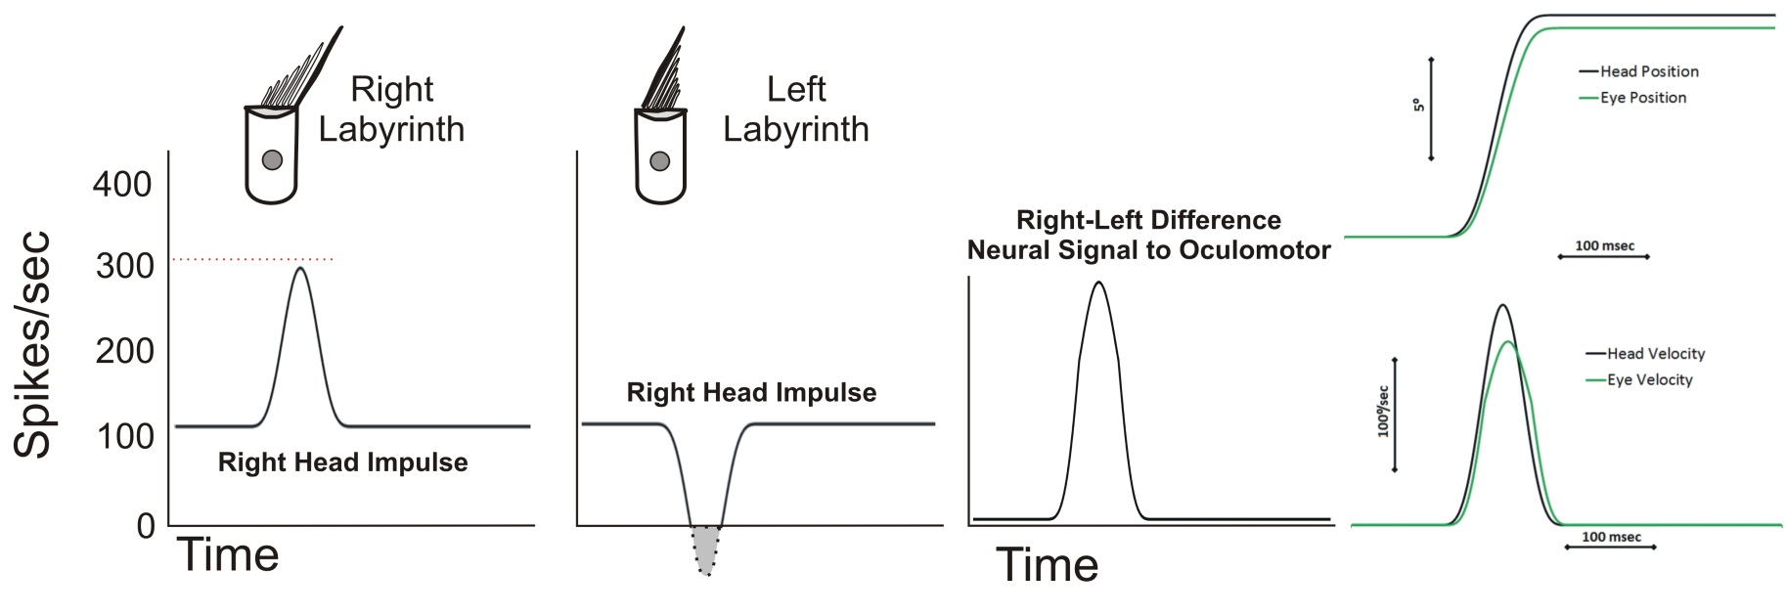
Head Impulse Test – Normal Responses
α head velocity
α head velocity
For head impulses (fast velocity), inhibitory neural responses saturate quickly while the excitatory responses remain proportional to head velocity
  A right head impulse will create a replica of head velocity.
  Responses to head impulses are mediated primarily by one labyrinth, although there is a small contribution from the other side
  VOR Gain = Eye Move./Head Move. ≈ 1 (Decreases slightly with increasing head velocity)
Diagram courtesy of Kamran Barin, PhD
Notes:
Now for head impulses, which are fast velocity. A right head impulse will create replica of head velocity. The other side (left labyrinth) is the problem. Once reach 0, or saturation, the L labyrinth has no idea where head is moving and can’t control eye movements. For normals, not a problem since other labyrinth is providing most of the information to the brain.

Slide 18
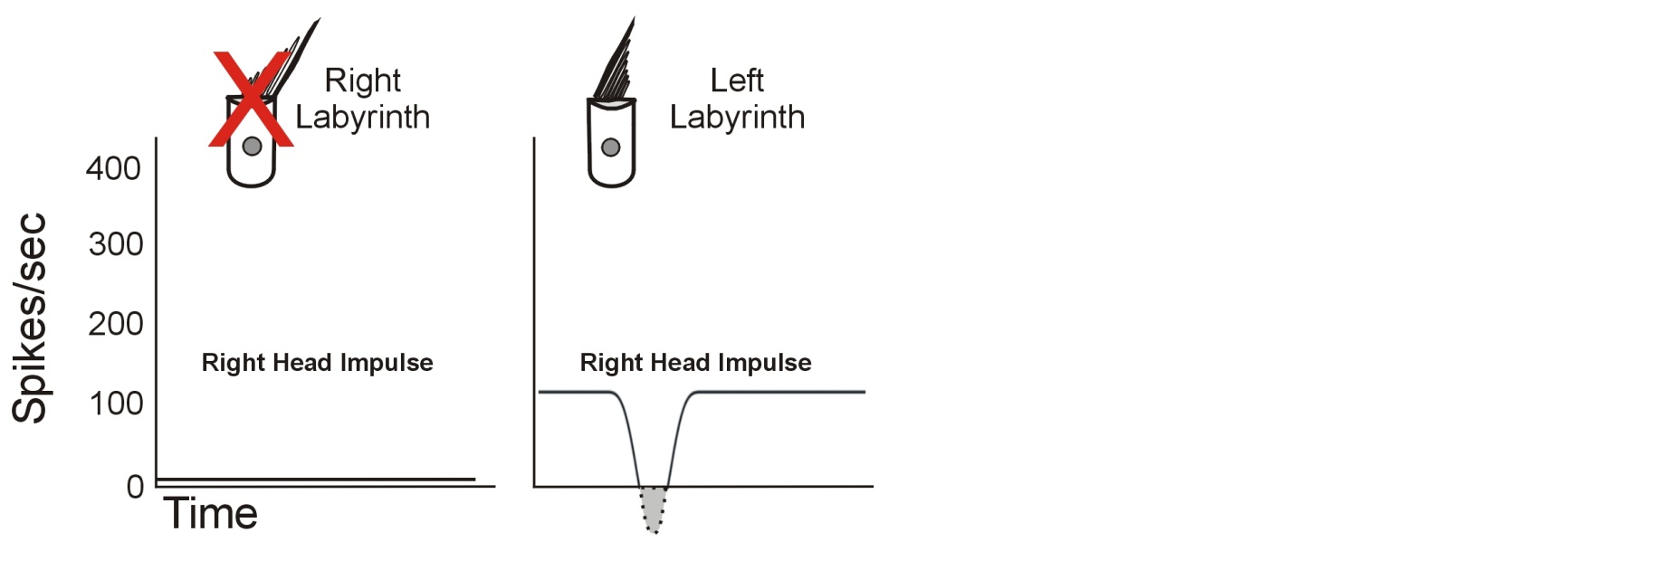
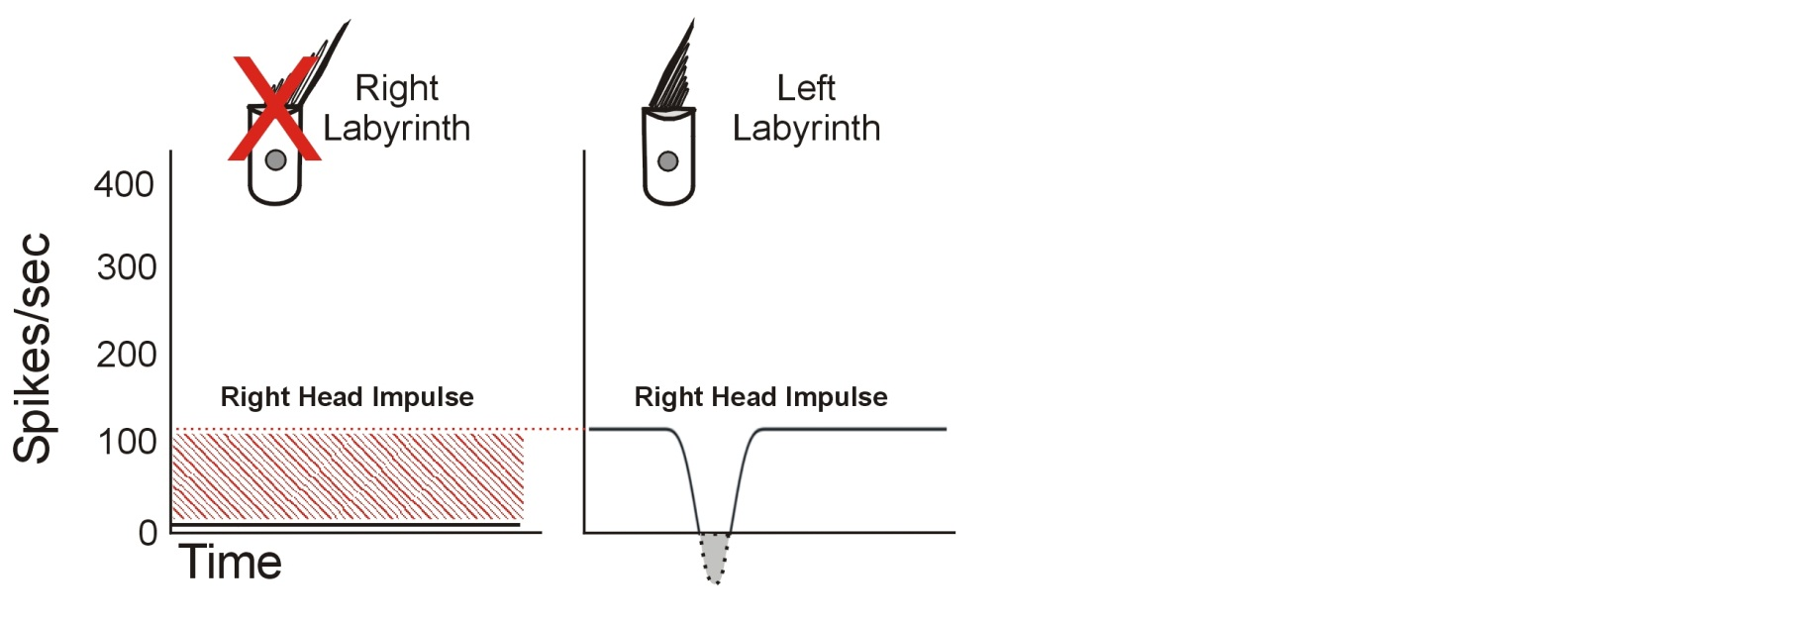
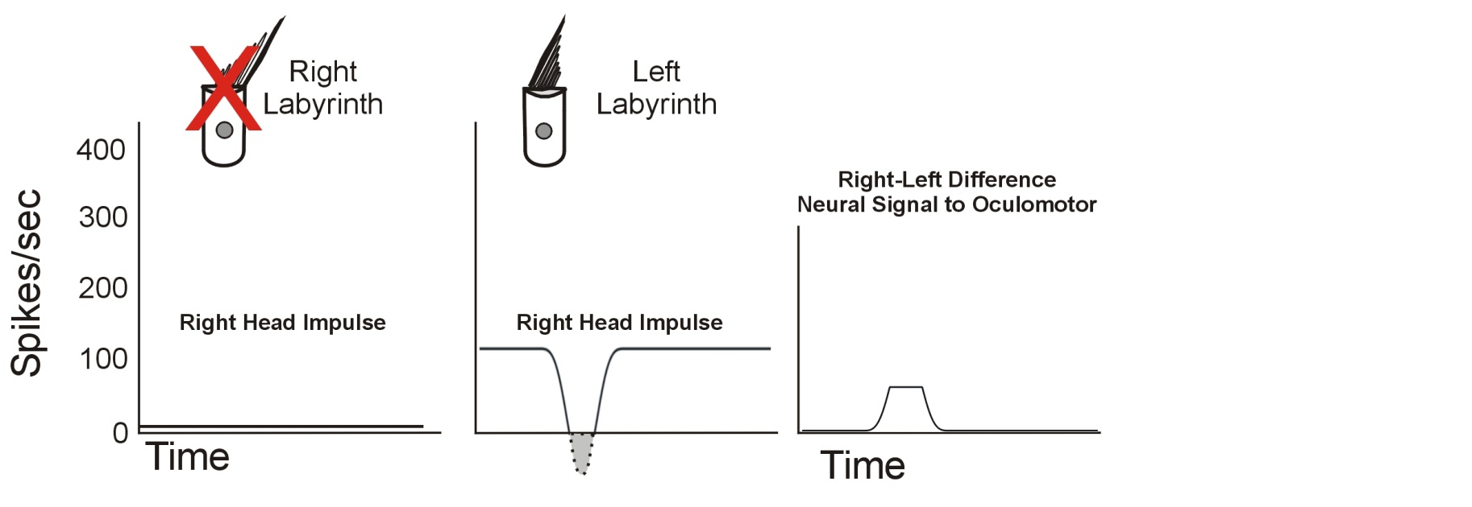
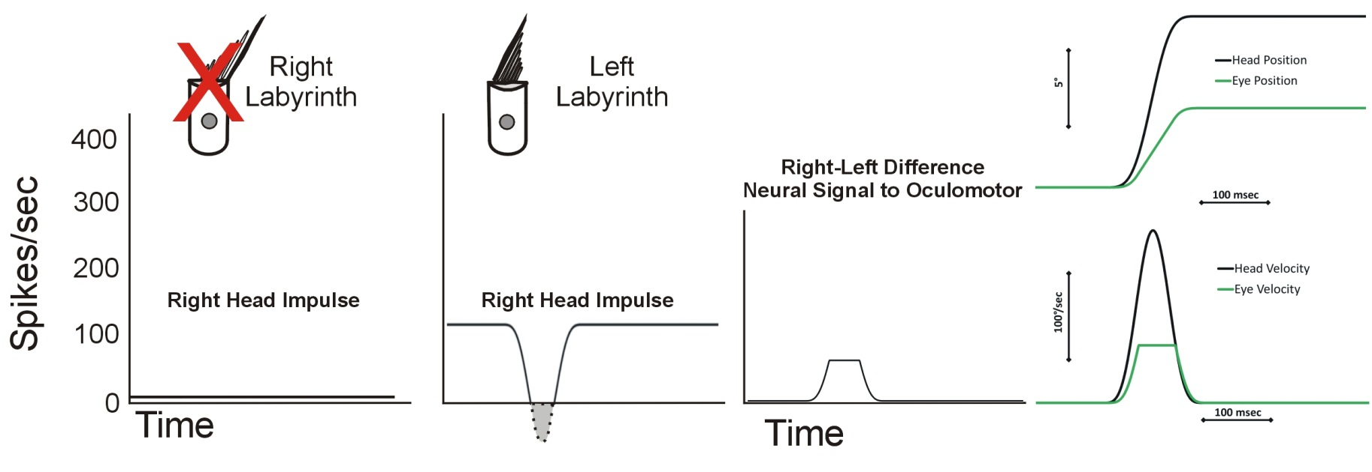
Head Impulse Test – Right Vestibular Lesion
When a labyrinth is damaged – 2 types of symptoms
  1. Static – vertigo, spontaneous nystagmus (absence of input in tonic/resting state leads to acute symptoms)
  2. Dynamic – no excitatory input contribution - only information from non-impaired side is sent to CNS
For head impulses toward the side of lesion, the replica of head velocity is gone and only minimal input is received (from the opposite side) so the CNS underestimates how much VOR to apply
Diagram courtesy of Kamran Barin, PhD
Notes:
If R labyrinth is damaged: will result in two types of symptoms. 1)static: vertigo, spontaneous nystagmus– because of absence of tonic activity results in acute symptoms, but there’s also 2)dynamic issue: with out the excitatory input from the right labyrinth, the only information being sent to theCNS is the inhibitory info from the L side. The replica of head velocity is gone. So now head moves here eyes move here and the eyes fall behind and short of the target. THIS IS ORIGIN OF CATCH UP SACCADE. Now VOR gain would be much less than 1.

Slide 19
Head Impulse Test – Right Vestibular Lesion
The resulting eye velocity does not match head velocity and the eyes fall short of target and must be repositioned on the target
VOR Gain = Eye Movement/Head Movement << 1 (decreases rapidly with increasing head velocity)
This is the origin of the catch-up saccade which appears on the plot above as a clipped response
Diagram courtesy of Kamran Barin, PhD
Notes:
If R labyrinth is damaged: will result in two types of symptoms. 1)static: vertigo, spontaneous nystagmus– because of absence of tonic activity results in acute symptoms, but there’s also 2)dynamic issue: with out the excitatory input from the right labyrinth, the only information being sent to theCNS is the inhibitory info from the L side. The replica of head velocity is gone. So now head moves here eyes move here and the eyes fall behind and short of the target. THIS IS ORIGIN OF CATCH UP SACCADE. Now VOR gain would be much less than 1.

Slide 20
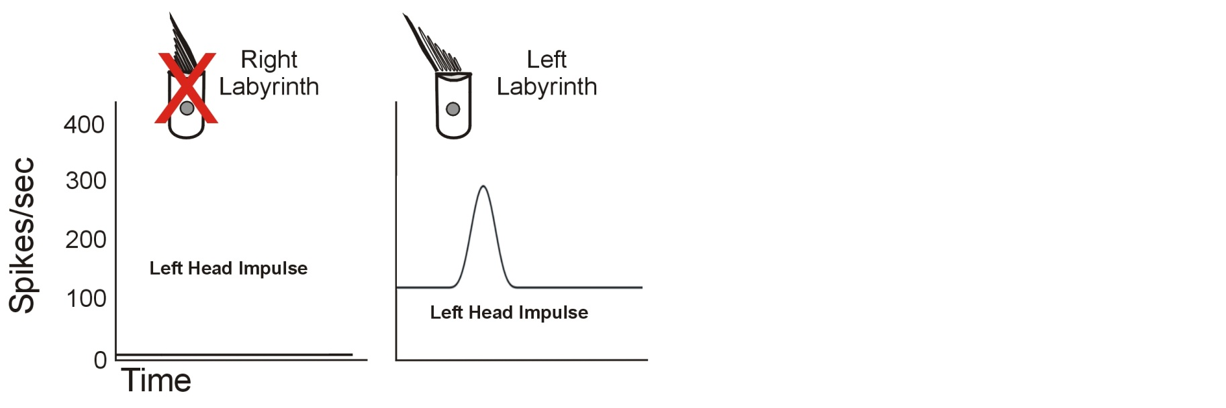
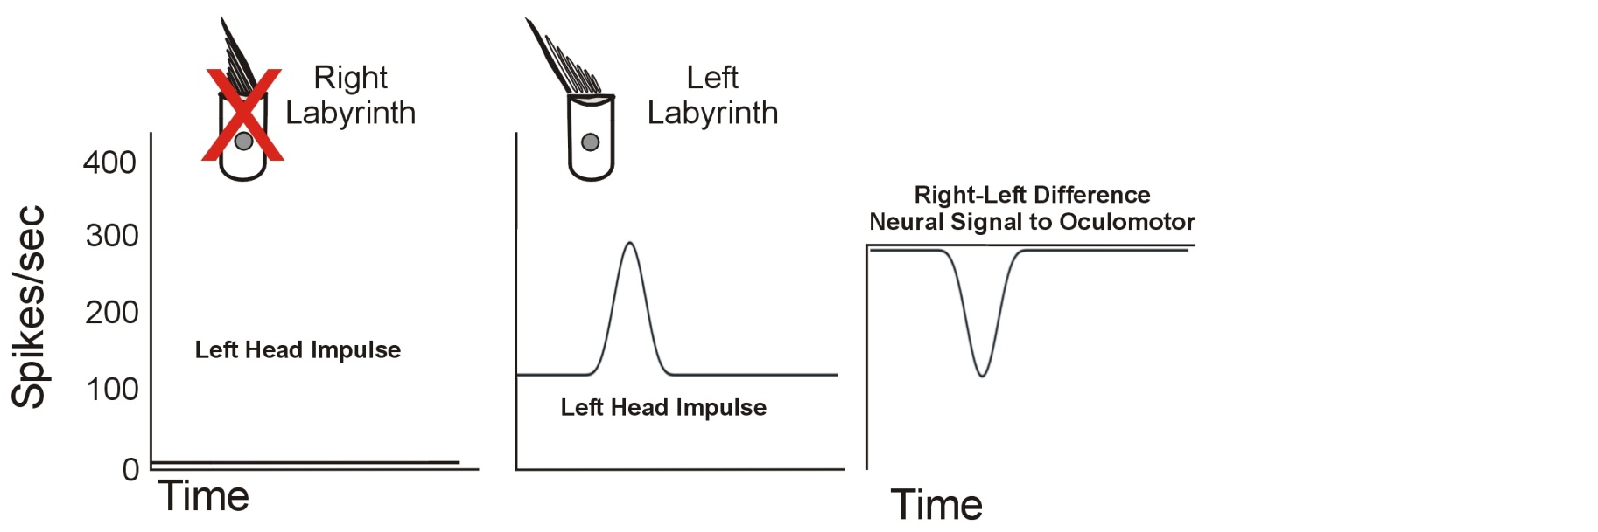
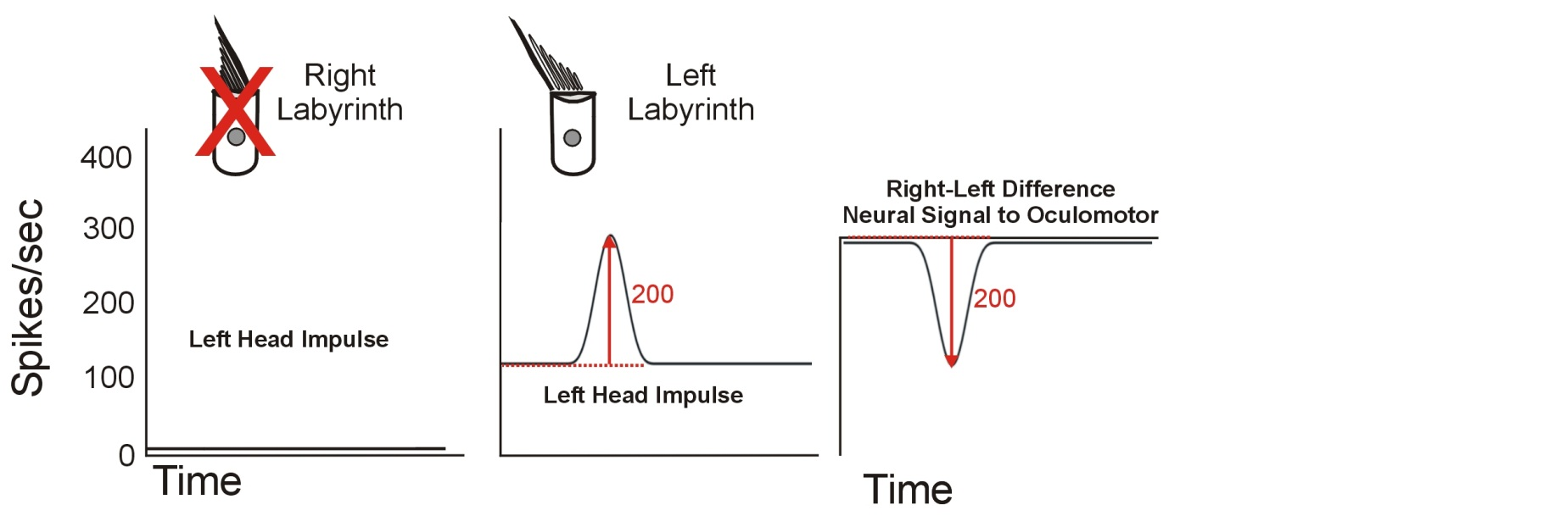
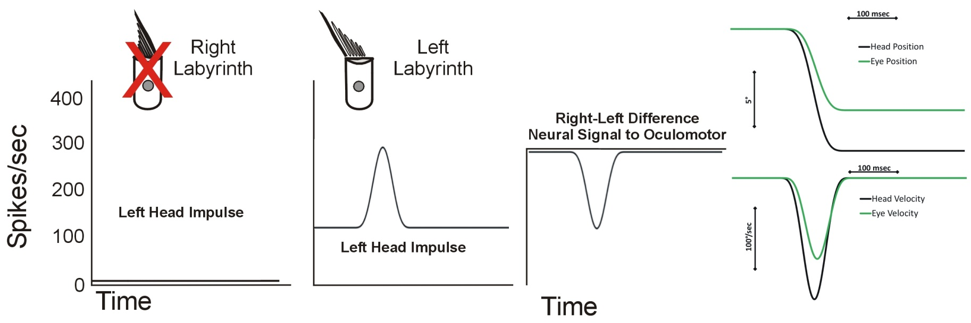
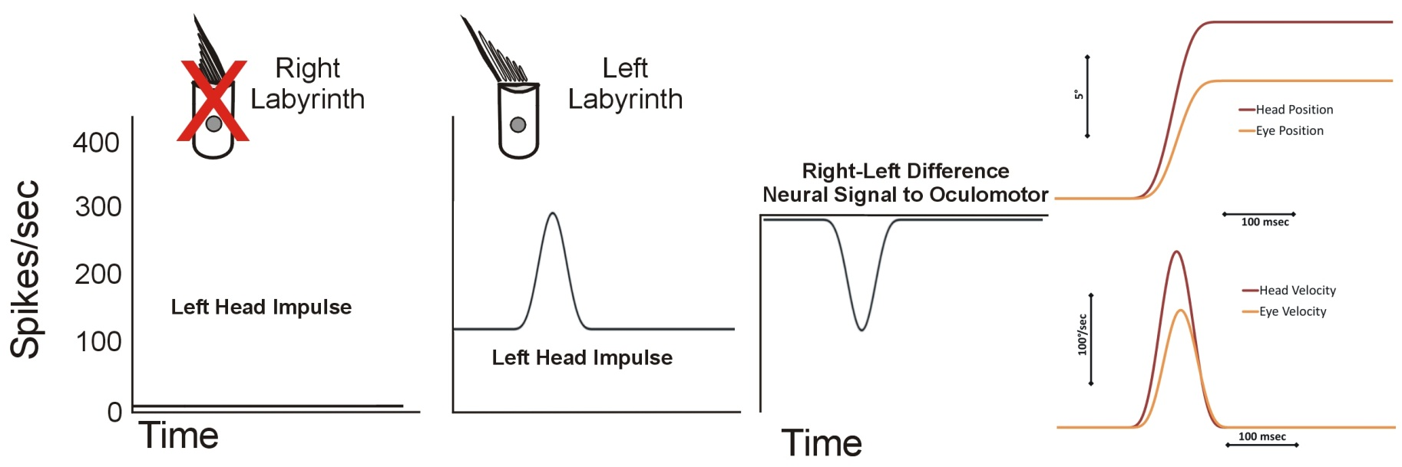
Head Impulse Test – Right Vestibular Lesion
For head impulses away from the side of lesion, the neural input to the oculomotor system is also reduced but to a much lesser extent, so it still does not match head velocity and the eyes fall somewhat short of target
VOR Gain = Eye Movement/Head Movement < 1
*So if both are abnormal, how do we know which is the side of lesion? The answer is in the difference in gain – one is just below normal and other is clearly abnormal (example to follow). (Also note that while gain is low, the pattern is correct)
Diagram courtesy of Kamran Barin, PhD
Notes:
Still not normal. Eyes velocity still reduced without inhibitory info, but not as much as side of lesion. So if both result in abnormal eye movements, how do you know which side has the lesion??? Side with lower gain is the side of lesion.
One more thing is notice eye movement is still proportional to head in non lesion side. <go back to prev slide> this one is clipped. This is important.

Slide 21
Overt Catch-Up Saccades – a closer view
Catch-Up Saccade
Catch-Up Saccade
Overt Saccade
Overt Saccade
All catch-up saccades reposition the eyes on the target
Catch-up saccades that occur after head impulses are called overt saccades
They are detectable by an experienced examiner because they occur after the head stops moving and are large.
Diagram courtesy of Kamran Barin, PhD
Notes:
To keep on target, a catch up saccade must be generated.
This is what velocity profile looks like

Slide 22
Covert catch-Up Saccades – a closer view
Catch-Up Saccade
Catch-Up Saccade
Covert Saccade
Covert Saccade
T2
T2
T1
T1
T1 = Decision to initiate saccade
T2 = Onset of actual saccade
T2 – T1 = Saccadic latency ≈ 70-150 msec
Catch-up saccades that occur during head impulses are called covert saccades. Covert saccades typically occur toward the end of head impulses because of the latency required (time between initiation and onset of the saccade).
It is not clear why some patients generate covert saccades while others do not - May be due to compensation levels or other yet unknown factors
Although large, the presence during head movement makes them nearly impossible to detect without special equipment.
Diagram courtesy of Kamran Barin, PhD
Notes:
Some patient’s are able to generate the compensatory eye movement during head motion. Mechanism is still not quite understood.

Slide 23
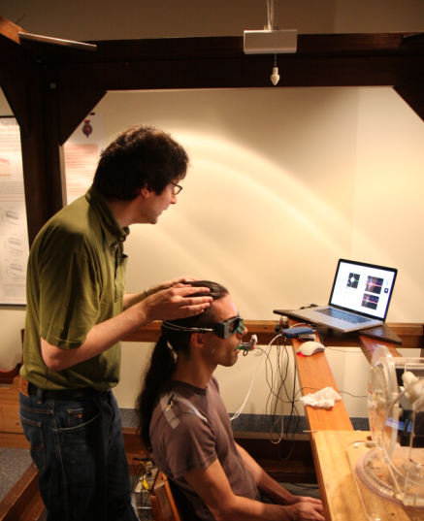
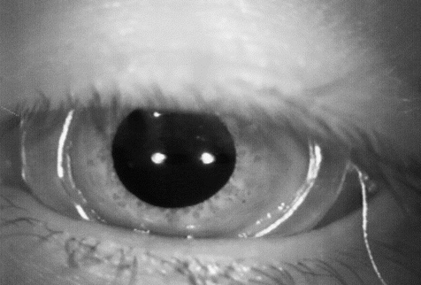
Beyond Observation: Scleral Search Coils
Halmagyi GM, Weber KP, Aw ST, Todd MJ, Curthoys IS (2008) Impulsive testing of semicircular canal function. In: Kennard C, Leigh RJ
(eds) Using Eye Movements as an Experimental Probe of Brain Function. Progress in Brain Research, volume 171, chapter 3.6, pp 187-194.
Notes:
Scleral search coils were found to be an acceptable objective measurement method, however, this is not a clinically feasible test.

Slide 24
The dilemma?
If the VOR is such a finely tuned mechanism…
And Head Impulse Testing directly measures the VOR…
Then Head Impulse Testing had the potential to be a significant clinical test.
The missing piece? Clinical feasibility.

Slide 25
Why not use VNG goggles or rotary chair to also record HIT results?

Slide 26
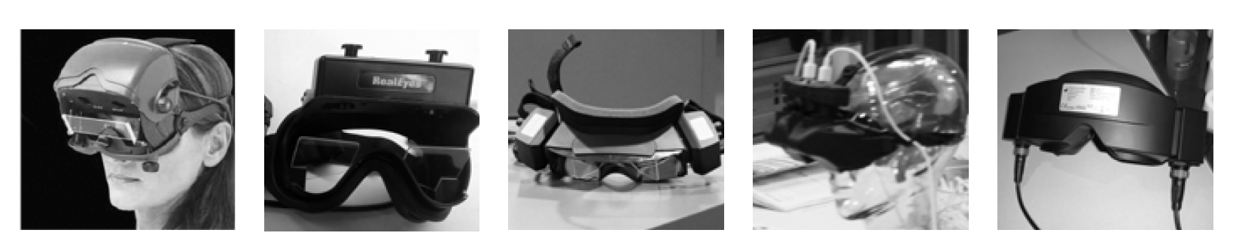
VNG Goggles
Standard VNG goggles are too bulky
Cannot detect some saccades, cameras too slow
Rotary Chair Testing
All issues associated with VNG goggles
Cannot reach sufficient velocity
  10 to 80 deg/sec
  Need 100 to 250 deg/sec for proper head impulse

Slide 27
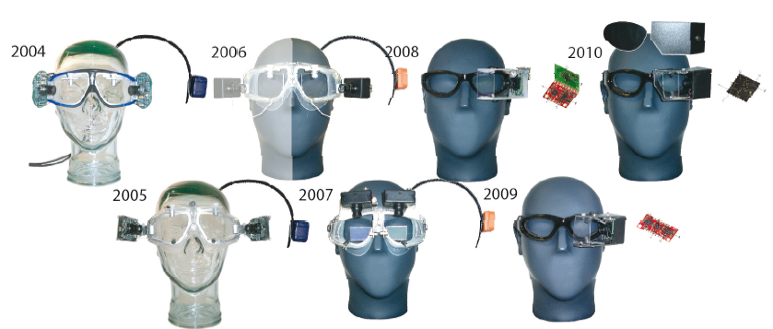
Moving beyond Scleral Search Coil
“ To reduce goggle slippage during the rapid head impulse test we have developed tight
fitting and lightweight (~60g) goggles with a high speed camera (250 Hz) and miniaturized
6DOF inertial sensors .” Hamish McDougall
Hamish McDougall, Konrad Weber, Leigh McGarvie, Leonardo Manzari, Michael Halmagyi, Ian Curthoys
Notes:
And the way to NOW

Slide 28
MacDougall HG, Weber KP, McGarvie LA, Halmagyi GM, Curthoys IS (2009) The video head impulse test: Diagnostic accuracy in peripheral vestibulopathy. Neurology 73 (14): 1134-1141.
  Horizontal HIT was recorded simultaneously with vHIT (250 Hz) and search coils (1,000 Hz) in 8 normal subjects, 6 patients with vestibular neuritis, 1 patient after unilateral intratympanic gentamicin, and 1 patient with bilateral gentamicin vestibulotoxicity.
Conclusions: The video head impulse test is equivalent to search coils in identifying peripheral vestibular deficits but easier to use in clinics, even in patients with acute vestibular neuritis.
New, powerful gold standard in VOR
Notes:
ICS Impulse—the ONLY system validated to the scleral search coil!!! This is important as the gold standard “was” the coil

Slide 29
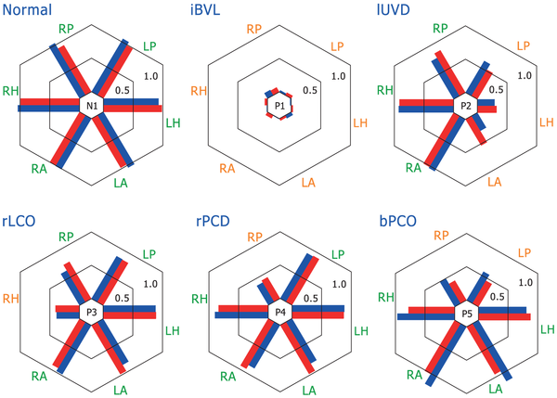
Prototype Goggle vs. Scleral Search Coil
MacDougall HG, McGarvie LA, Halmagyi GM, Curthoys IS, et al. (2013) The Video Head Impulse Test (vHIT) Detects Vertical Semicircular Canal Dysfunction. PLoS ONE 8(4): e61488. doi:10.1371/journal.pone.0061488 http://www.plosone.org/article/info:doi/10.1371/journal.pone.0061488
Notes:
VOR gain comparison of simultaneous coil and vHIT searches
ar plots of VOR gain for simultaneous search coils (red) and video measures (blue) for 6 representative subjects and patients. Bars are plotted side by side to facilitate comparison and arranged radially to indicate the results from head impulses delivered in planes of the: Right Anterior (RA), Left Anterior (LA), Right Horizontal (RH), Left Horizontal (LH), Right Posterior (RP), and Left Posterior (LP) semicircular canals. The data shown are for a range of patient conditions: Normal (same subject as in Figure 2); idiopathic Bilateral Vestibular Loss (iBVL; same patient as in Figure 3); left Unilateral Vestibular Deafferentation (lUVD; same patient as in Figure 4) after surgery for vestibular Schwannoma; right Lateral Canal Occlusion (rLCO) for intractable benign paroxysmal positional vertigo; idiopathic right Posterior Canal Dysfunction (rPCD; same patient as in Figure 5); and Bilateral Posterior Canal Occlusion (bPCO; same patient asFigure S1) for intractable benign paroxysmal positional vertigo. Results show a range of responses from canals in these patients, each with a pattern of canal responses that usually matches the expectation based on previous literature, but importantly the pattern of response on coils and video measures remains similar across a broad range of canal responses and diagnoses

Slide 30
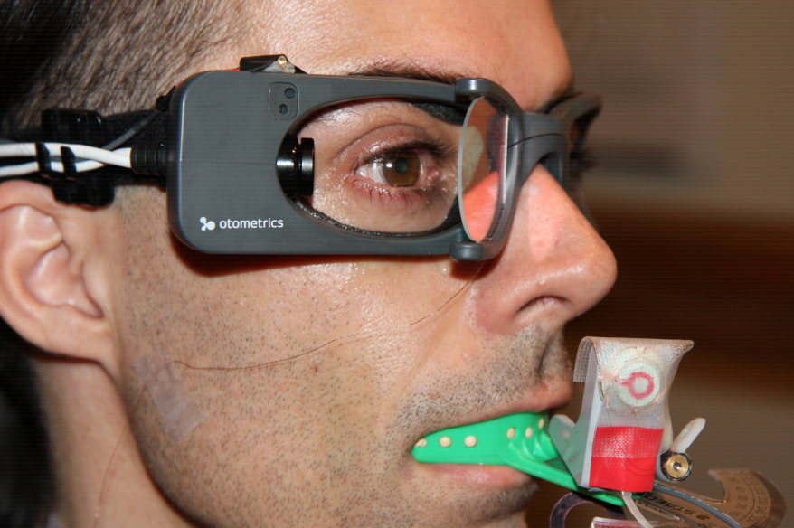
Prototype Goggle vs Scleral Search Coil

Slide 31
MacDougall HG, Weber KP, McGarvie LA, Halmagyi GM, Curthoys IS (2009) The video head impulse test: Diagnostic accuracy in peripheral vestibulopathy. Neurology 73 (14): 1134-1141.
  Horizontal HIT was recorded simultaneously with vHIT (250 Hz) and search coils (1,000 Hz) in 8 normal subjects, 6 patients with vestibular neuritis, 1 patient after unilateral intratympanic gentamicin, and 1 patient with bilateral gentamicin vestibulotoxicity.
Conclusions: The video head impulse test is equivalent to search coils in identifying peripheral vestibular deficits but easier to use in clinics, even in patients with acute vestibular neuritis.
New, powerful gold standard in VOR
Notes:
ICS Impulse—the ONLY system validated to the scleral search coil!!! This is important as the gold standard “was” the coil

Slide 32
Prototype Goggle vs Scleral Search Coil
MacDougall HG, McGarvie LA, Halmagyi GM, Curthoys IS, et al. (2013) The Video Head Impulse Test (vHIT) Detects Vertical Semicircular Canal Dysfunction. PLoS ONE 8(4): e61488. doi:10.1371/journal.pone.0061488 http://www.plosone.org/article/info:doi/10.1371/journal.pone.0061488
Notes:
VOR gain comparison of simultaneous coil and vHIT searches

Slide 33
vHIT vs Visual Observation/Bedside Testing
Impulse can identify covert saccades
Validates that head impulse is performed properly
Sensitivity and specificity are 95% - with reduction in false negatives (identifing patients as normal who are truly abnormal)
Provides objective analysis with normative data for comparison over time
Better patient comfort during test (don’t need large head thrusts)
Notes:
VISUAL OBSER SENS/SPEC AT 70% FOR VIS OBS WEBER, KP, AW ST, TODD MJ, MCGARVIE LA, CURTHOYS IS, HALMAGYI GM. HEAD IMPULSE TEST IN UNILATERAL VESTIBULAR LOSS: VOR AND CATCH UP SACCADES NEUROLOGY 2008 70(6): 454-463

Slide 34
Performing vHIT

Slide 35
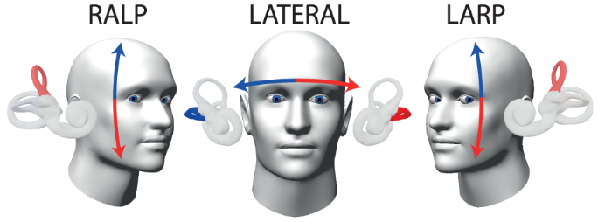
Video HIT: Evaluate all six canals
MacDougall HG, McGarvie LA, Halmagyi GM, Curthoys IS, et al. (2013) The Video Head Impulse Test (vHIT) Detects Vertical Semicircular Canal Dysfunction. PLoS ONE 8(4): e61488. doi:10.1371/journal.pone.0061488
http://www.plosone.org/article/info:doi/10.1371/journal.pone.0061488

Slide 36
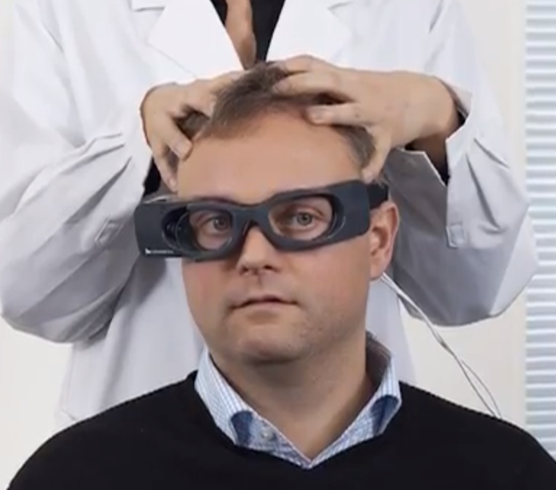
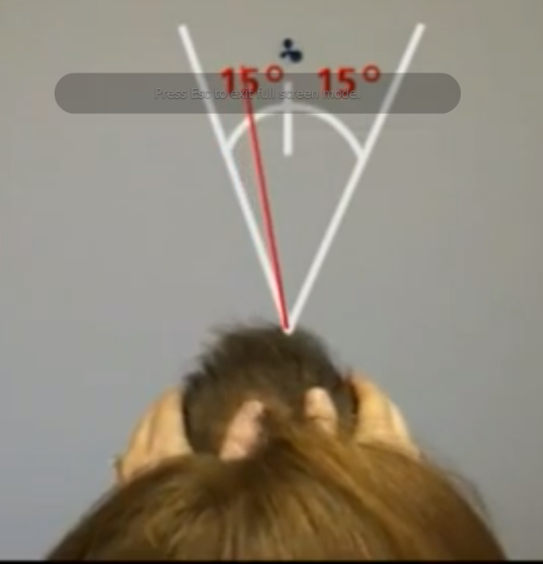
Performing Lateral Impulses
Place goggles (tight fit required) and adjust pupil tracking
Place hands on top of patient’s head - DO NOT touch strap or goggles
Have patient stare at fixation dot
Move head quickly and unpredictably ~ 15° to left or right of fixation dot
  High velocity and small amplitude
Monitor software for velocity and accuracy

Slide 37
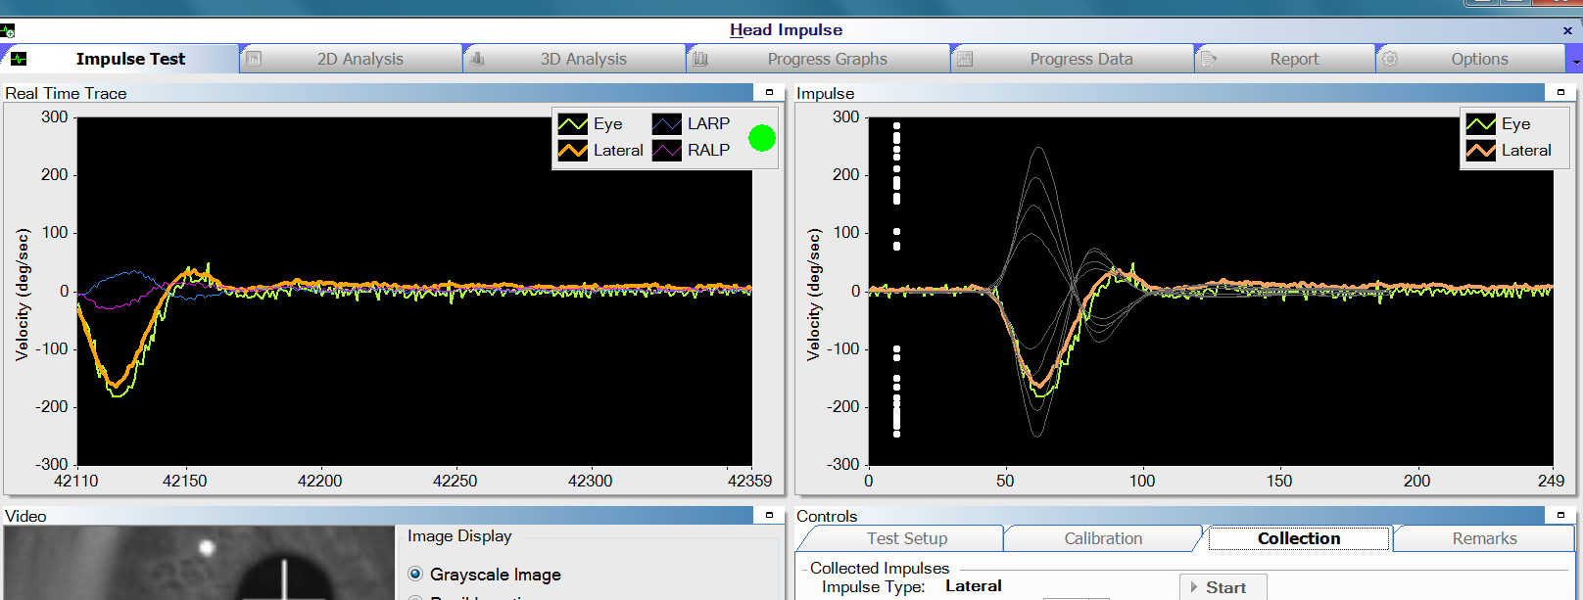
Example of Results
Acceptable head impulses are analyzed for accurate performance, plotted by velocity, and analyzed for presence of sacccades

Slide 38
Performing Impulses
Passive for patient – performed by clinician
Unpredictable – avoid pattern
Multiple velocities between 100-250 degrees/second
Not include overshoot/rebound

Slide 39

Vertical Canal Tests
MacDougall HG, McGarvie LA, Halmagyi GM, Curthoys IS, et al. (2013) The Video Head Impulse Test (vHIT) Detects Vertical Semicircular Canal Dysfunction. PLoS ONE 8(4): e61488. doi:10.1371/journal.pone.0061488
http://www.plosone.org/article/info:doi/10.1371/journal.pone.0061488

Slide 40
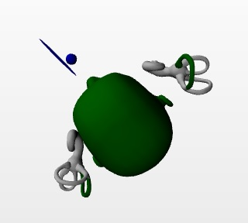
Performing Vertical Impulses - LARP and RALP
After performing lateral impulses:
Select the appropriate test (RALP or LARP)
Select ‘Center’ Button and turn the patient’s head until image turns yellow or green
    Counter-clockwise for RALP
    Clockwise for LARP
Adjust pupil tracking
Begin Test (No need to re-calibrate)

Slide 41
Head Impulse Test Results

Slide 42
Criteria for Abnormality
Presence of Saccades - can be identified based on their direction, timing, velocity, and consistency
VOR gain (slow eye movement / head movement where head/eye movements can be based on position, velocity, or acceleration)
Gain asymmetry (difference between VOR gain for rightward and leftward head impulses)

Slide 43
vHIT Interpretation
Catch-up saccades occur within a specific time window after the onset of head impulse (~70 msec to the end of head motion for covert saccades and within ~200 msec after the end of head motion for overt saccades)
Saccades that are substantially smaller than the peak head velocity should not be considered as catch-up saccades
The exact parameters for the timing and velocity of catch-up saccades are still emerging but the presence of consistent catch-up saccades should be considered abnormal even when the VOR gain is within normal limits

Slide 44
ICS Impulse – Gain Graph
Gain – ratio of the eye movement velocity to the head movement velocity
  Right = red
  Left = blue
Peak Velocity – maximum velocity representing that particular head impulse test
Normative Data:
  White = within normal limits
  Light Grey = unilateral loss
  Dark Grey = bilateral loss
  Average (mean) of all gains for Right/Left and standard deviation
  Cutoffs can be changed under Options window

Slide 45
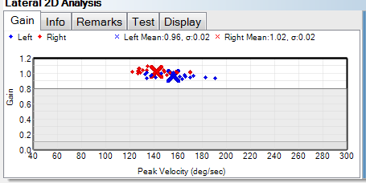
ICS Impulse – Gain Graph
Notes:
Gain – ratio of the eye movement velocity to the head movement velocity;Right = red; Left = blue
Peak Velocity – maximum velocity representing that particular head impulse test
Normative Data: White = within normal limits Light Grey = unilateral loss Dark Grey = bilateral loss
Average (mean) of all gains for Right/Left and standard deviation
Cutoffs can be changed under Options window

Slide 46
Head Impulse Testing – Normal
What does a patient within normal limits exhibit?
Gain (comparison of eye and head movement)
  Greater than 0.8 for Lateral
  Greater than 0.7 for LARP/RALP
Saccades
  May have a few saccades but nothing significant
Spontaneous Nystagmus
  May be present or absent

Slide 47
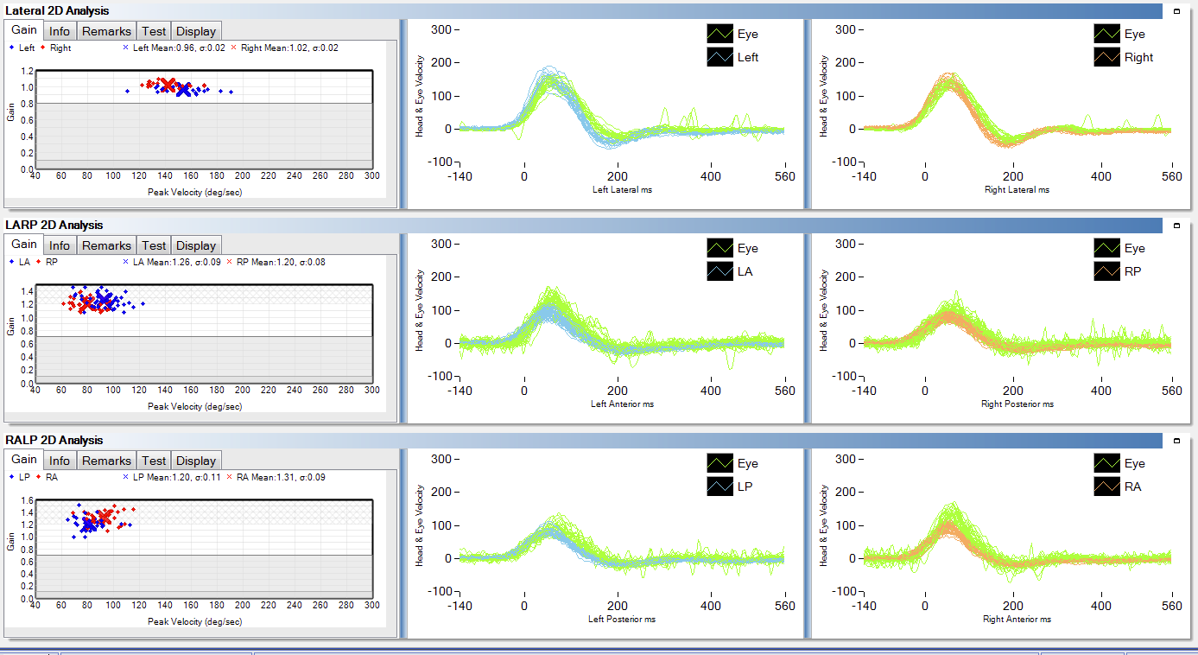
Head Impulse Testing – Normal 2D
The head data shows very well performed head impulses and the eye data shows a vestibular ocular reflex that mirrors the head velocities.
Downward spikes are a result of spontaneous nystagmus.

Slide 48
Hex Plot
Provides Simultaneous view of:
Gain
    Green Bar : Normal
    Orange Bar: Low Gain
2D tracing
Asymmetry for every canal pair

Slide 49
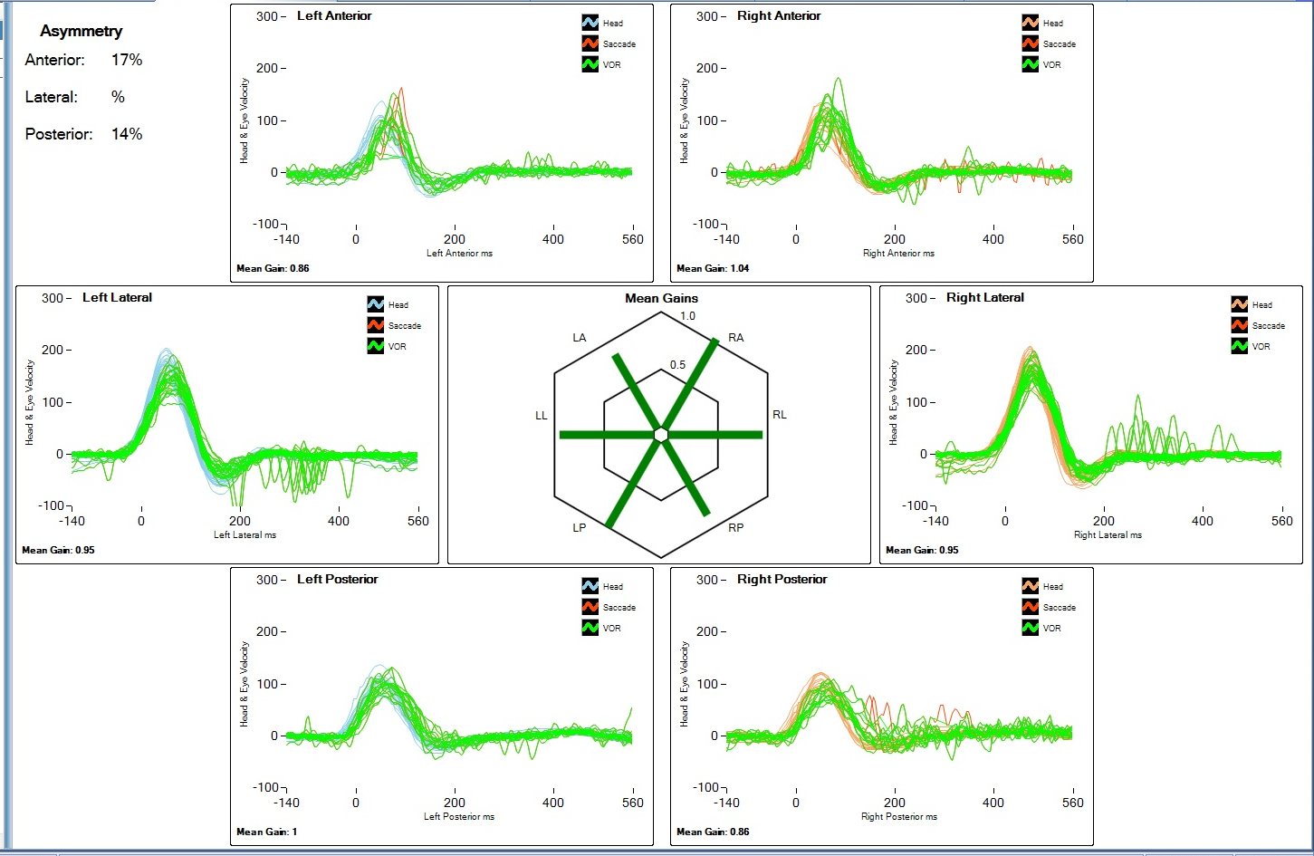
Hex Plot - Normal

Slide 50
Head Impulse Testing – Overt
What does a patient with a vestibular loss exhibit?
Gain (comparison of eye and head movement)
  Less than 0.8 is abnormal for Lateral
  Less than 0.7 is abnormal for LARP/RALP
    0.1 to 0.8 if unilateral loss for Lateral
    0.1 to 0.7 if unilateral loss for LARP/RALP
    Less than 0.1 if bilateral loss
Saccades
  An overt corrective saccadic eye movement (a “catch-up” saccade) after the head impulse
Spontaneous Nystagmus
  May be present or absent

Slide 51
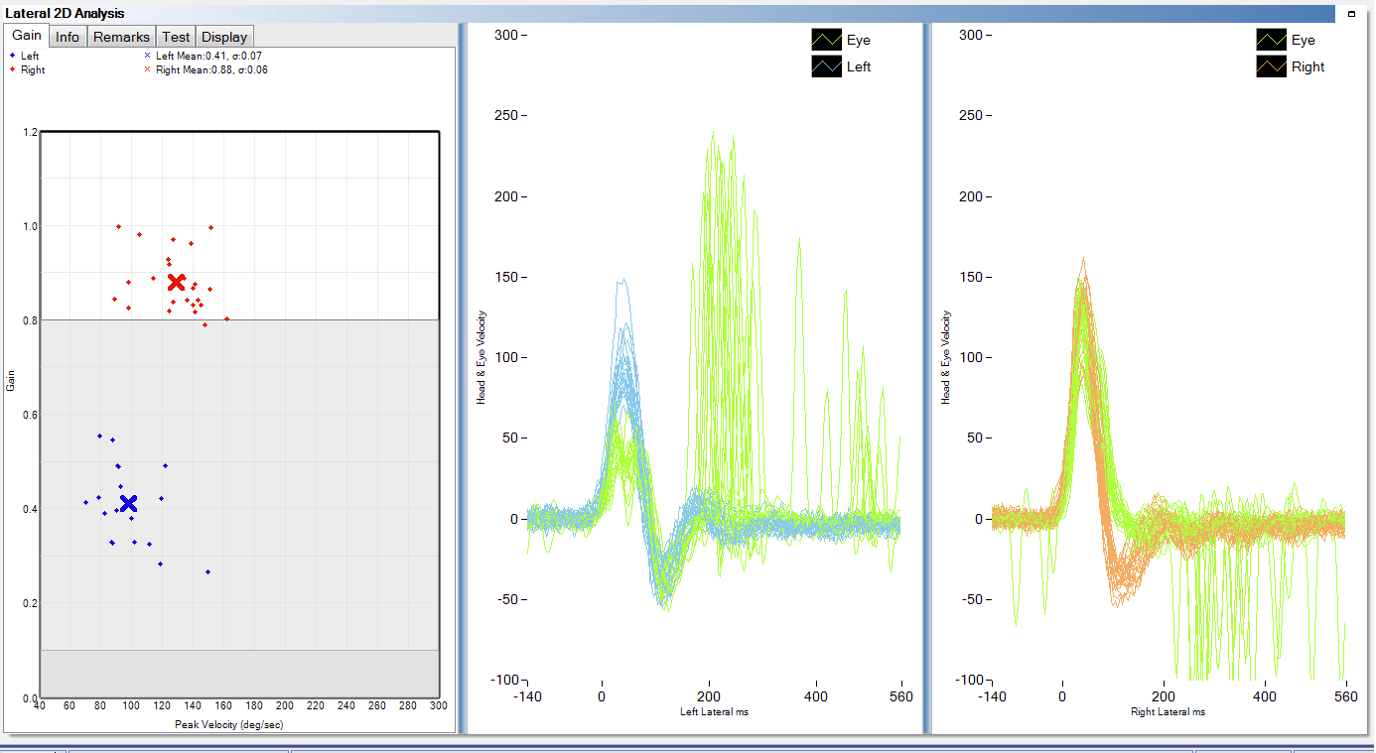
Head Impulse Testing – Overt 2D
The head data shows very well performed head impulses and the eye data shows an inadequate vestibular ocular reflex (A) that does not mirror the head velocities.
There are overt catch-up saccades present. Catch-up saccades are easier to visualize in the 3D analysis.

Slide 52
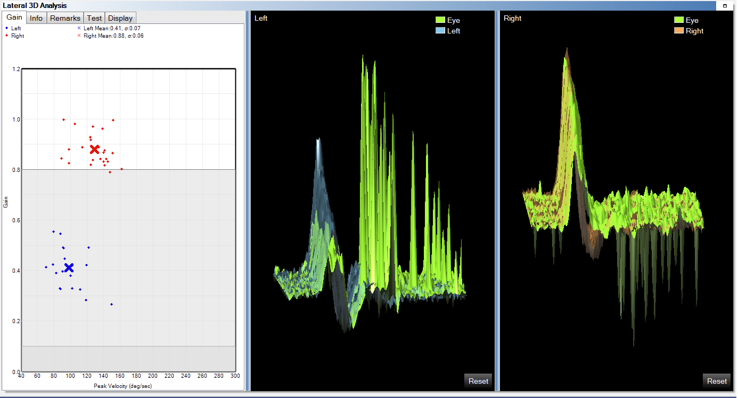
Head Impulse Testing – Overt 3D
The head data shows very well performed head impulses and the eye data shows an inadequate vestibular ocular reflex (A) that does not mirror the head velocities.
There are overt catch-up saccades present. Catch-up saccades are easier to visualize in the 3D analysis.

Slide 53
Head Impulse Testing – Covert
What does a patient with a vestibular loss exhibit?
Gain (comparison of eye and head movement)
  Less than 0.8 is abnormal for Lateral
  Less than 0.7 is abnormal for LARP/RALP
    0.1 to 0.8 if unilateral loss for Lateral
    0.1 to 0.7 if unilateral loss for LARP/RALP
    Less than 0.1 if bilateral loss
Saccades
  A covert corrective saccadic eye movement (a “catch-up” saccade) during the head impulse
Spontaneous Nystagmus
  May be present or absent

Slide 54
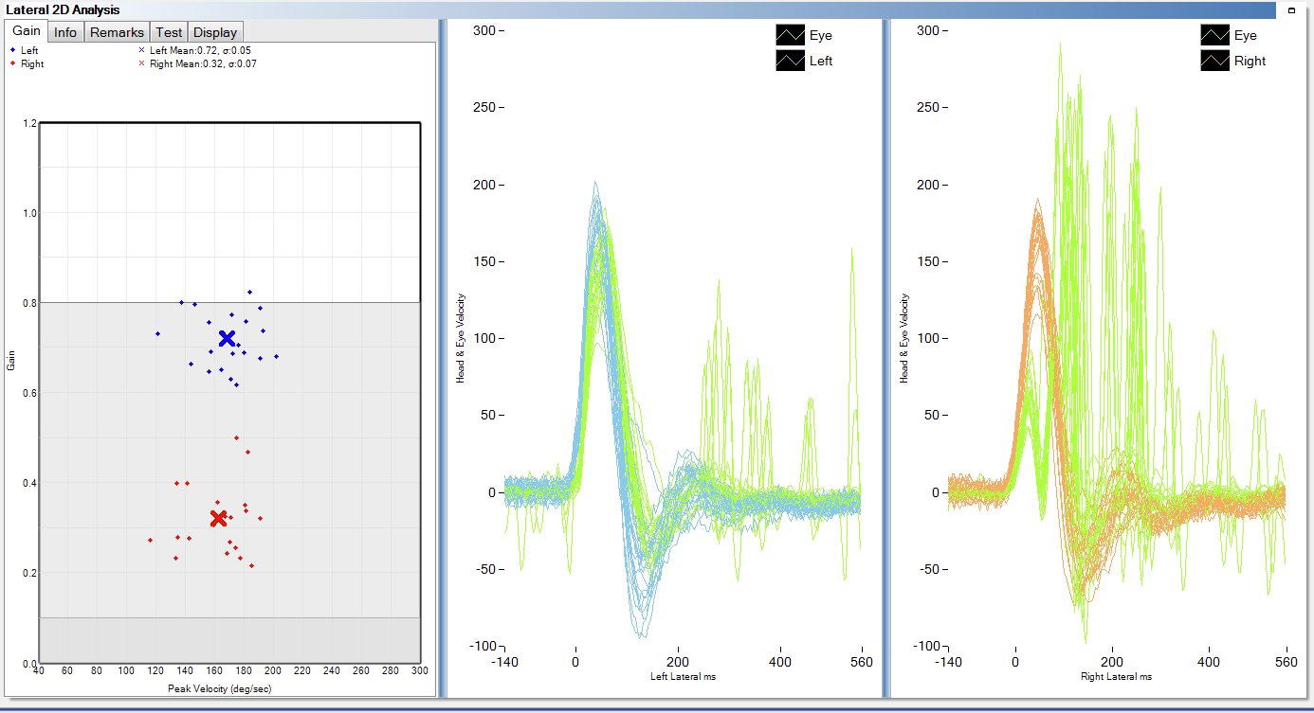
Head Impulse Testing – Covert 2D
The head data shows very well performed head impulses and the eye data shows an inadequate vestibular ocular reflex (A) that does not mirror the head velocities.
There are covert catch-up saccades present. Catch-up saccades are easier to visualize in the 3D analysis.

Slide 55
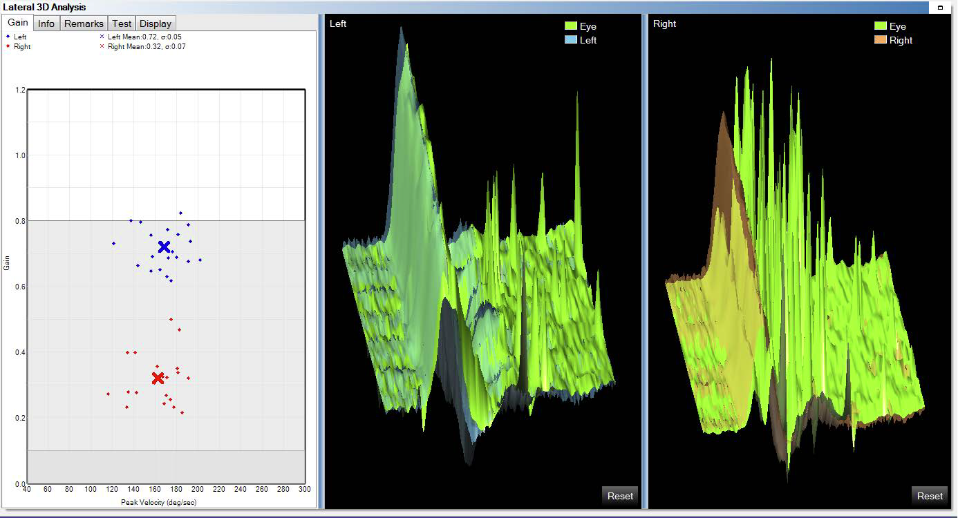
Head Impulse Testing – Covert 3D
The head data shows very well performed head impulses and the eye data shows an inadequate vestibular ocular reflex (A) that does not mirror the head velocities.
There are covert catch-up saccades present. Catch-up saccades are easier to visualize in the 3D analysis.

Slide 56
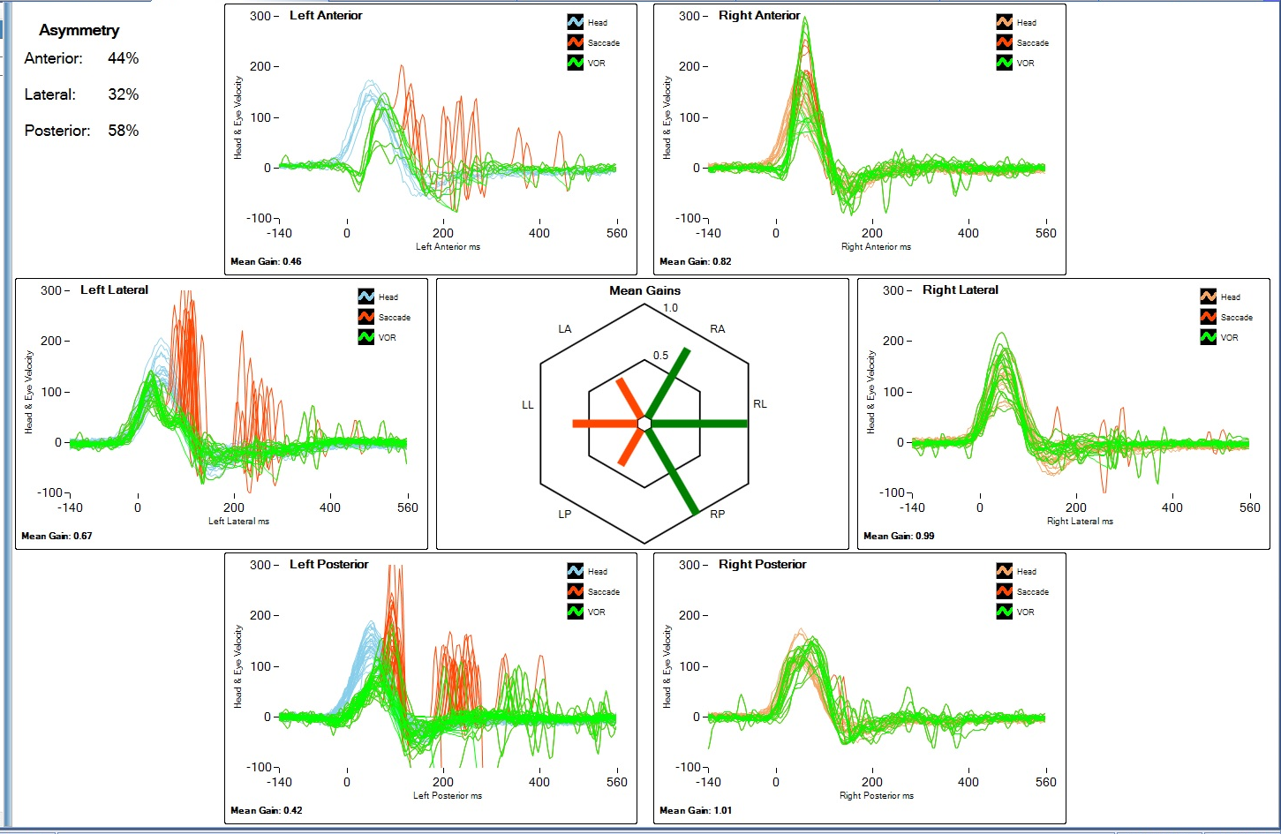
Hex Plot – Unilateral Weakness

Slide 57
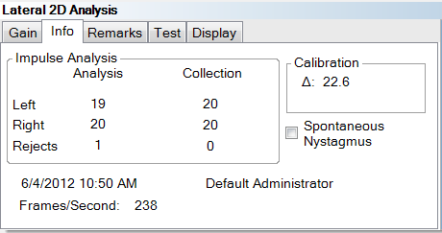
A note on Spontaneous Nystagmus
What should you do if the patient has spontaneous nystagmus – select this option in the system
Uses a different algorithm for head impulse acceptance (if not checked good head impulses are rejected)
Reanalyze if raw data was saved without this algorithm applied

Slide 58
vHIT Testing – Implications & Applications

Slide 59
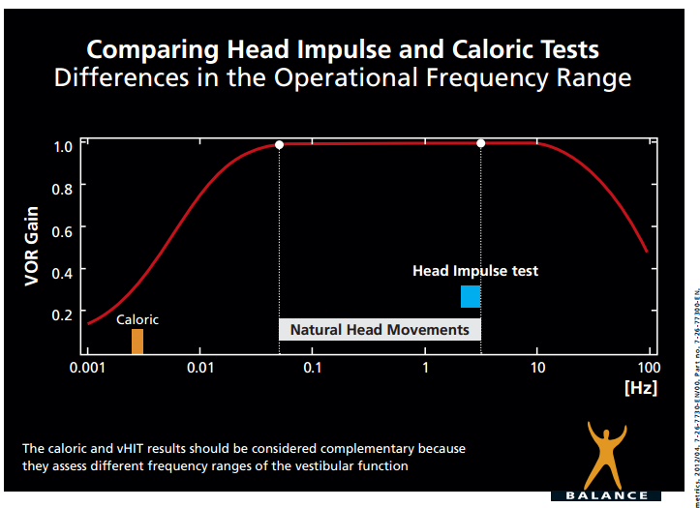
A Full Range of Frequencies
Active Head
Rotary Chair
www.icsimpulse.com

Slide 60
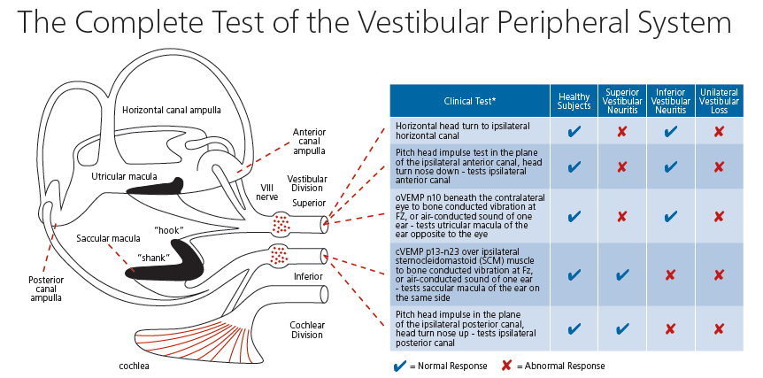
Site of lesion differentiation

Slide 61
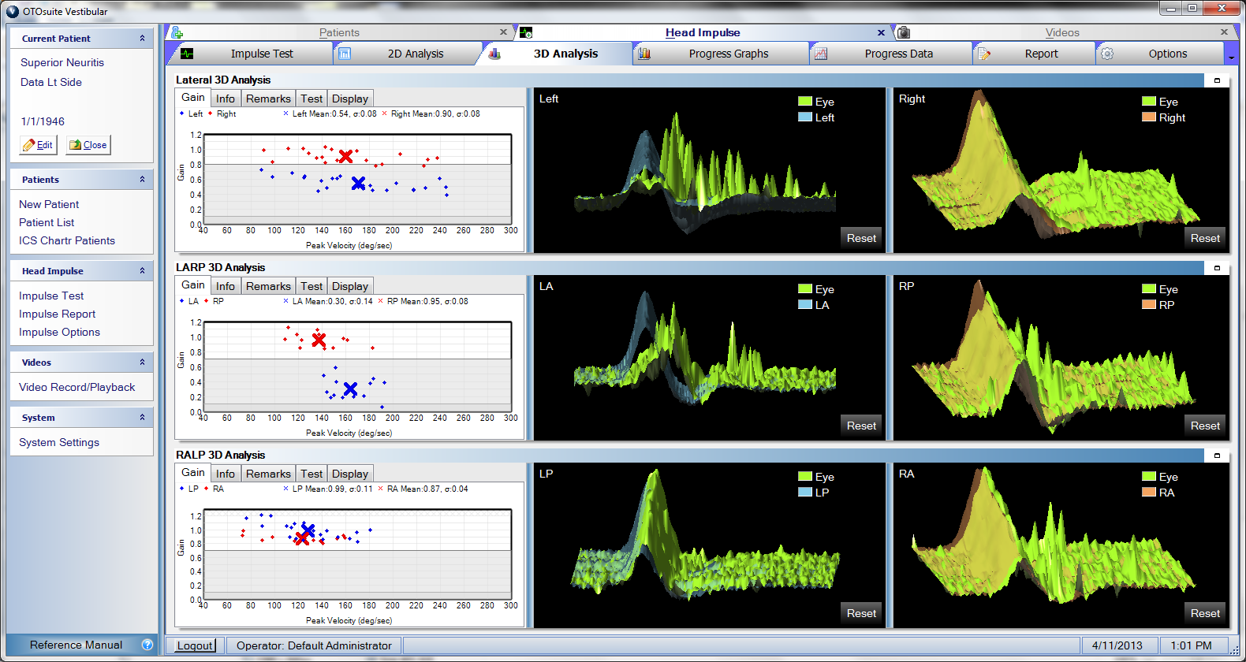
Left Superior Vestibular Neuritis – Lateral and Anterior Canals

Slide 62
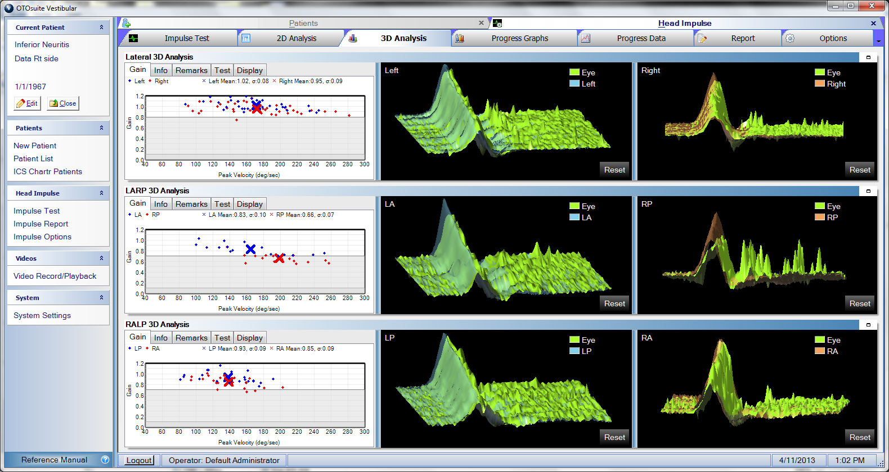
Right Inferior Vestibular Neuritis – Posterior Canal

Slide 63
Applications of vHIT
Can serve as entry point of vestibular assessment
Enhances our assessment to include vertical canals and more subtle abnormalities. Knowing where lesion is (and how extensive) may have implications for rehabilitation and recovery expectations.
Use in conjuction oVEMP/cVEMP to assess all portions of the vestibular system
Use for pediatric patients and others unable to tolerate traditional testing
So much more to uncover… remember the clinical launch of OAE’s?

Slide 64
How can we use it?
Pediatric Vestibular Assessment
Cochlear Implant Assessments
Can be used for stroke detection in ER >>
Vestibular Ablation – IT Injections
TBI and Concussions
Physical Therapy
New Understandings of Pathways and Physiology

Slide 65
vHIT Testing - Reimbursement

Slide 66
Reimbursement
CPT Code 92700 – Unspecified Otolaryngology Procedure
Accompanied with:
  An explanation of the presenting sign or symptom that caused one or more of these procedures to be performed for this patient
  A complete description of what was done and what was found
  A description of any equipment that was used in the evaluation process and a justification for its necessity
  A description of your clinical assessment and interpretation of the test outcomes
  The length of time required to complete the evaluation
  Included in this report should be sufficient information to justify why these procedures were done in addition to or in place of other diagnostic procedures that have standard CPT codes.

Slide 67
Reimbursement
CPT Code 92700 – Unspecified Otolaryngology Procedure
Accompanied with:
  An explanation of the presenting sign or symptom that caused one or more of these procedures to be performed for this patient
  A complete description of what was done and what was found
  A description of any equipment that was used in the evaluation process and a justification for its necessity
  A description of your clinical assessment and interpretation of the test outcomes
  The length of time required to complete the evaluation
  Included in this report should be sufficient information to justify why these procedures were done in addition to or in place of other diagnostic procedures that have standard CPT codes.

Slide 68
Reimbursement for 92700
Can be billed > 1 time per date of service
Must use 59 modifier EACH time to indicate separate and distinct procedure
Otherwise, multiple services will likely be rolled into one service
Anyone who is authorized to use CPT codes can report this code
This code is also recommended by billing and coding experts for VEMP

Slide 69
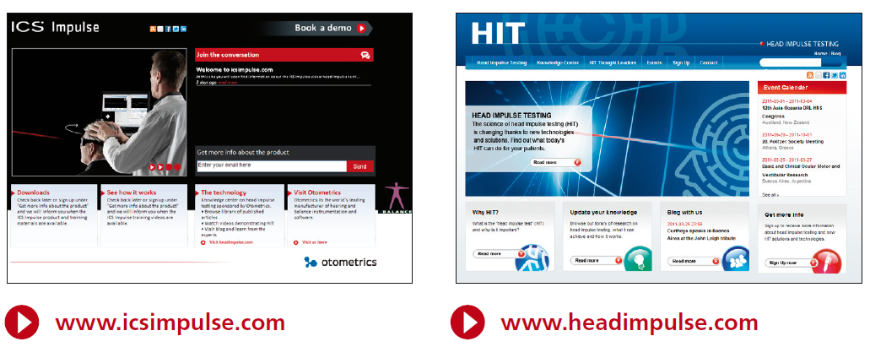
Stay updated
khill@otometrics.com

